Slide 1
Word Forms
My Brother is very success

Slide 2
Adjectives
Modify nouns, nouns phrases, pronouns
Often answer the question, What kind?
May follow the verb to be

Slide 3
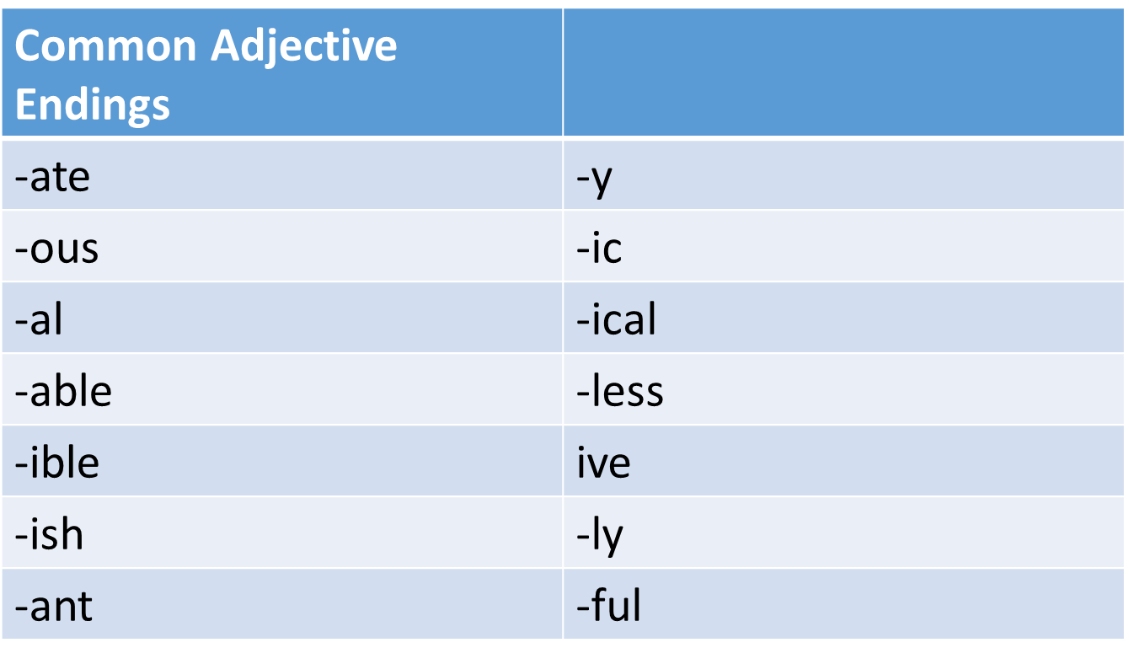

Slide 4
Adverbs:
Modify verbs, participles, adjectives,
Prepositions, adverb clause markers,
other adverbs
Most adverbs on the TOFEL are adverbs of
manner
Often answer the question, How?

Slide 5
Common Adverb Endings
-ly | -ally

Slide 6
A words have the same form as adverbs and adjectives
 | Adjective | adverb
Fast | He bought a fast car | He was driving so fast he got a speeding ticket
Hard | The algebra test was hard | He pushed the door open hard and it hit him in the face
High | The kite was so high up in the sky I couldn’t see it | The kite flew high; I thought I was going to lose it.

Slide 7
Just because a word ends in –ly
Doesn’t mean you can assume it is an adverb
Adjective
Friendly | I found Houston to be a very friendly city
Costly | That was a costly mistake

Slide 9
Noun Endings
Suffix | Verb | noun
-tion | Inform | information
-sion | Provision | Provide
-ence | Existence | Exist
-ance | Acceptance | Accept
-ity | Create | Creativity

