Slide 1
Early Start English
Tuesday Thursday 1:00 – 1:50
Online Wednesday Friday

Slide 2
Your name
The email address that you check REGULARLY
Your major
Where you are going to school next year
Your goals for this course
Something fun about yourself

Slide 3
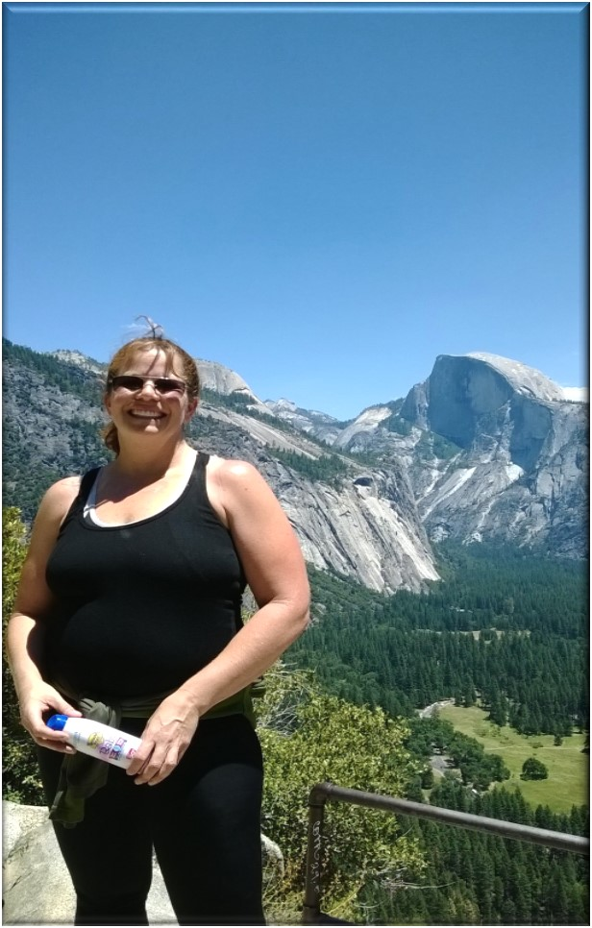
Karen Zandarski
kzandarski@csustan.edu
Karenzandarski.weebly.com

Slide 4
Close Reading
The How and Why of Engaging with Your Text

Slide 5
Close Reading
At the heart of most college courses
The ability to read a text carefully
Apply formalistic criticism to it in order to understand, evaluate and use the text

Slide 6
Linguistic:
surface linguistic elements of the text (words)
aspects of vocabulary, grammar, and syntax noting figures of speech that contribute to style.

Slide 7
2. Semantic:
Review specific words in a passage at a deeper level
understand what information is being conveyed. Notice what words mean.
reading is understanding what is being said on the surface
Reading for what is implied.

Slide 8
3. Structural:
Note the relationships between words in the text
reading is analytic.
assess, examine, sift, and judge a large number of items from within the text in their relationships to each other.

Slide 9
4. Cultural:
Note the relationships between the text to things outside it reading is interpretive.
Judgments are made on the work and its relationship to a large body of material outside it.

