Slide 1
Grammar
Past Perfect & Past Progressive

Slide 2
Review
Past Perfect – used to put past events in a time order
key words: had, when, by the time, while

Slide 3
Past Perfect Progressive
Gives background reasons or describes events. Emphasizes
an on going past action.
Example: They had been experiencing many challenges,
so they decided to make a pack.
First action: Second (ongoing) action:

Slide 4
Reading:
Three Young Men Make a Pact
What is the American Dream?
Why is this story remarkable?
What are some events in the story?

Slide 5
Your lives at home were probably quite different from
your new lives here.
Share some things they had been doing in
your home counties before you came to school for their
English studies.
Example, ‘I had been studying at the university’.

Slide 6
The past perfect progressive often stresses the length of time a person had been doing a certain activity.
Take a small slip of paper.
Each one has a length of time written on it (one year, two weeks, six month, ten minutes, etc.).
Each person takes a turn drawing a card and then sharing something they had been doing for that length of time before any other event.
Example: a student who draws two years might say, ‘I had been studying English for two years before coming to the U.S.’

Slide 7
Write a simple past tense sentence on the index card
Be creative and funny in the sentences.
After cared are redistributed
You must now use that simple sentence in a dependent clause (starting with when) and create a main clause using the past perfect progressive that will make a logical sentence.
For example:
First sentence: The bear ate the campers’ food.
Second sentence, When the bear ate the campers’ food, the people had been swimming in the lake.

Slide 8
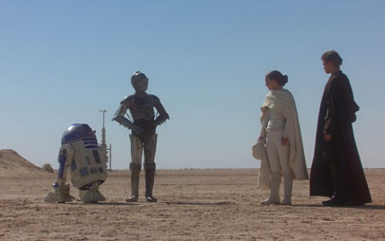
Homework for Thursday:
Imagine you run into an old friend you have not seen for a
long time.
Write a short dialogue to this friend tell him/her about
how you life has changed. Use past perfect/progressive
when possible.

