Slide 1
Grammar
Tuesday and Thursday 9 – 10:30
Karen Zandarski

Slide 2
Your Goals:
Please take out a piece of paper
Write down your goals for:
this class – what do you want
learn about grammar?
This semester in college?
What do you want to accomplish
in school between now and May 31? By going to college?
What is your career goal?
INCLUDE AT THE BOTTOM OF THE PAPER YOUR NAME AND EMAIL ADDRESS

Slide 3
Today’s Agenda:
Review syllabus
Review class rules and expectations
Introduce first assignments
Introducing each other to your instructor

Slide 4
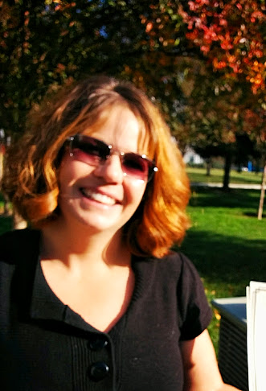
Your Instructor
Karen Zandarski
kzandarski@csustan.edu

Slide 5
Take a number
Find the person or persons with the. same number
Sit together
Interview your partner or partners to find out the answers to the questions I
on the sheet

Slide 6
Homework:
Practice reading the information about
Your partner. You will have to read it
out loud to the class THURSDAY

