Slide 1
Reading Games

Slide 2
Critical reading is careful, thorough, thoughtful, and active reading.
Not negative or quick reading.
You are involved in critical reading
You are interested in a text - (even if you fake it)
You make a variety of comments about it as you read it.
Academic text means a text that is specifically written for use by college instructors or students.

Slide 3
“Rhetorical reading refers to a
set of practices designed to help us understand how texts work and to
engage more deeply and fully in a conversation that extends beyond
the boundaries of any particular reading” (4).

Slide 4
Reading should be thought of as a conversation between the author you and other authors
We should pay attention to our own agenda as we read
Think about what the text says
Think about how the text says what it says

Slide 5
Audience
The title
The abstract
The introduction
section headings
The conclusion
What is the main argument or idea?

Slide 6
READING SHOULD BE ACTIVE:
Methods of interacting with text: Cornell Notes
Double entry journal
Margin notes
Others…..

Slide 7
“The phone offered other delights that paper couldn’t. Midway through the book, voice dictation on the iPhone started to get really, really good. I’d been doing a lot of highlighting while reading Tolstoy, saving my favorite sentences and passages. I wasn’t writing a lot of marginalia because typing on the phone broke my flow a bit too much. But once the voice dictation became fluid, I quickly discovered I could highlight a cool passage and then dash off a paragraph of my own observations, dictating it like Henry James to his secretaries. I startedtalking to the book — or rather, talking to Siri’s servers, which were transcribing my speech (and, unnervingly, saving copies of everything I say for two years. The audio of my rambling thoughts about Tolstoy are still out there in the aether.).
By the time I was done with War and Peace, I had amassed 12,322 words of highlights and marginalia. It was a terrific way to remind myself of the most resonant parts of Tolstoy. Indeed, I so enjoyed revisiting those notes that I wanted a paper copy of them. Using the Espresso print-on-demand machine at the McNally Jackson bookstore in New York, I had the notes printed up as a small 84-page paperback. It sits on my shelf, a little compilation of my reading and thinking — or, as I titled it, War in Pieces” (Reading War and Peace on My iphone).

Slide 8
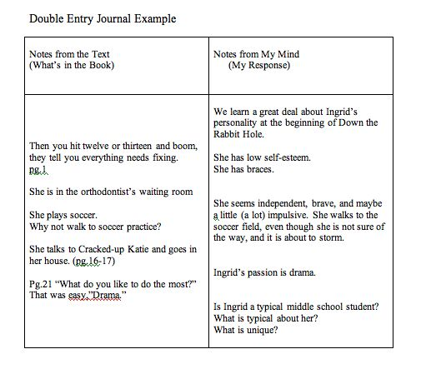

Slide 10
Summary -
The goal of writing a summary of a text is to mirror the text in much shorter form in your own words

