Slide 1
TEFOL Prep
Karen Zandarski
Tuesday – Thursday 9:00 – 10:30

Slide 2
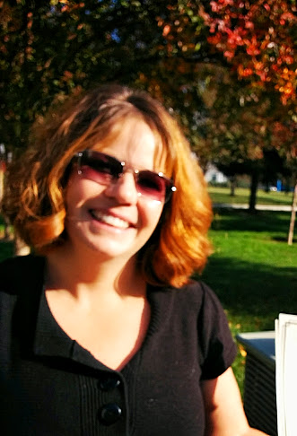
Your Instructor:
Karen Zandarski
kzandarski@csustan.edu

Slide 3
Agenda Wednesday Jan 28:
Review Syllabus
Begin TOFEL Practice Test

Slide 4
Homework for Friday Jan 30:
None

